Slide 1
Introduction to Java

Slide 2
What is Java
Java Technology consists of:
• Java Language
• Java Platform
• Java Tools
Java language is a general-purpose programming language. It can be used to develop software for mobile devices, browser-run applets, games, as well as desktop, enterprise (server-side), and scientific applications.
Java platform consists of Java virtual machine (JVM) responsible for hardware abstraction, and a set of libraries that gives Java a rich foundation.
Java tools include the Java compiler as well as various other helper applications that are used for day-to-day development (e.g. debugger).

Slide 3
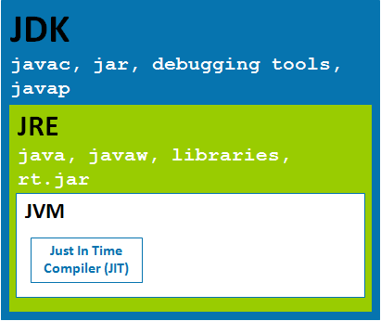
JDK – JRE - JVM
A Java distribution comes typically in two flavors, the Java Runtime Environment (JRE) and the Java Development Kit (JDK).
The Java runtime environment (JRE) consists of the JVM and the Java class libraries and contains the necessary functionality to start Java programs.
The JDK contains in addition the development tools necessary to create Java programs. The JDK consists therefore of a Java compiler, the Java virtual machine, and the Java class libraries.

Slide 4
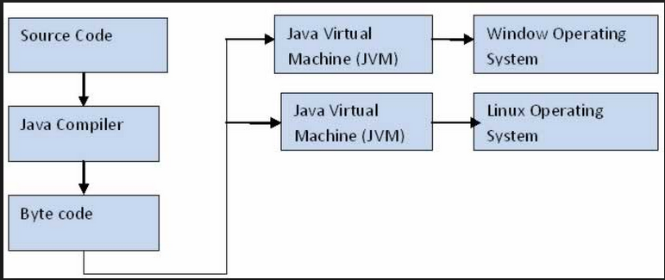
Architecture

Slide 5
Characteristics of Java
Java has the following properties:
Platform independent:
Java programs use the Java virtual machine as abstraction and do not access the operating system directly. This makes Java programs highly portable. A Java program (which is standard complaint and follows certain rules) can run unmodified on all supported platforms, e.g. Windows or Linux.
Object-orientated programming language:
Except the primitive data types, all elements in Java are objects.
Strongly-typed programming language:
Java is strongly-typed, e.g. the types of the used variables must be pre-defined and conversion to other objects is relatively strict, e.g. must be done in most cases by the programmer.
Interpreted and compiled language:
Java source code is transferred into the bytecode format which does not depend on the target platform. These bytecode instructions will be interpreted by the Java Virtual machine (JVM). The JVM contains a so called Hotspot-Compiler which translates performance critical bytecode instructions into native code instructions.

Slide 6
Characteristics of Java..
Simple
Java has a familiar syntax, automatic memory management, exception handling, single inheritance, standardized documentation, and a very rich set of libraries (no need to reinvent the wheel).
Secure/Robust
Due to its support for strong type checking, exception handling, and memory management, Java is immune to buffer- overruns, leaked memory, illegal data access. Additionally, Java comes with a Security Manager that provides a sand-box execution model.
Scalable
Thanks to its overall design, Java is scalable both in terms of performance/throughput, and as a development environment. A single user can play a Java game on a mobile phone, or millions of users can shop though a Java-based e-commerce enterprise application.
High-performance/Multi-threaded
With its HotSpot Just-in-Time compiler, Java can achieve (or exceed) performance of native applications. Java supports multi-threaded development out-of-the-box.

Slide 7
Characteristics of Java..
Automatic memory management:
Java manages the memory allocation and de-allocation for creating new objects. The program does not have direct access to the memory. The so-called garbage collector deletes automatically objects to which no active pointer exists.
Dynamic
Java can load application components at run-time even if it knows nothing about them. Each class has a run-time representation.
Distributed
Java comes with support for networking, as well as for invoking methods on remote (distributed) objects through RMI.

Slide 8

Write once Run Anywhere
The Interpreter's are sometimes referred to as the Java Virtual Machines

Slide 9
JVM
The .class files generated by the compiler are not executable binaries
  so Java combines compilation and interpretation
Instead, they contain “byte-codes” to be executed by the Java Virtual Machine
  This approach provides platform independence, and greater security

Slide 10
JVM..
At run time, the JVM reads and interprets .class files and executes the program's instructions on the native hardware platform for which the JVM was written.
The JVM interprets the bytecodes just as a CPU would interpret assembly-language instructions.
The difference is that the JVM is a piece of software written specifically for a particular platform.
The JVM is the heart of the Java language's "write-once, run-anywhere" principle. Your code can run on any chipset for which a suitable JVM implementation is available.
JVMs are available for major platforms like Linux and Windows, and subsets of the Java language have been implemented in JVMs for mobile phones and chips.

Slide 11
Compiling and Running
Compiler: a program that converts a program in one language to another language
compile from C++ to machine code
compile Java to bytecode
Bytecode: a language for an imaginary cpu
Interpreter: A converts one instruction or line of code from one language to another and then executes that instruction
When java programs are run the bytecode produced by the compiler is fed to an interpreter that converts it to machine code for a particular CPU

Slide 12
The Garbage Collector
Rather than forcing you to keep up with memory allocation (or use a third-party library to do this), the Java platform provides memory management out of the box.
When your Java application creates an object instance at run time, the JVM automatically allocates memory space for that object from the heap, which is a pool of memory set aside for your program to use.
The Java garbage collector runs in the background, keeping track of which objects the application no longer needs and reclaiming memory from them.
This approach to memory handling is called implicit memory management because it doesn't require you to write any memory-handling code.
Garbage collection is one of the essential features of Java platform performance.

Slide 13
Java Version History
Major release versions of Java, along with their release dates:
• JDK 1.0 (January 21, 1996)
• JDK 1.1 (February 19, 1997)
• J2SE 1.2 (December 8, 1998)
• J2SE 1.3 (May 8, 2000)
• J2SE 1.4 (February 6, 2002)
• J2SE 5.0 (September 30, 2004)
• Java SE 6 (December 11, 2006)
• Java SE 7 (July 28, 2011)
• Java SE 8 (March 18, 2014)

Slide 14
Questions???

Slide 15
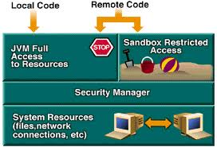
Java Security Model
Java's security model is focused on protecting users from hostile programs downloaded from untrusted sources across a network.
To accomplish this goal, Java provides a customizable "sandbox" in which Java programs run.
A Java program must play only inside its sandbox. It can do anything within the boundaries of its sandbox, but it can't take any action outside those boundaries.

Slide 16
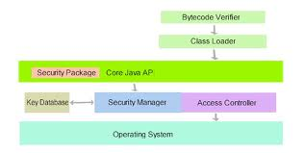
Sandbox Security Model
The fundamental components responsible for Java's sandbox are:
• Safety features built into the Java virtual machine (and the language)
• The class loader architecture
• The class file verifier
• The security manager and the Java API

Slide 17
Java Security Model..
The sandbox for untrusted Java applets, for example, prohibits many activities, including:
• Reading or writing to the local disk
• Making a network connection to any host, except the host from which the applet came
• Creating a new process
• Loading a new dynamic library and directly calling a native method
By making it impossible for downloaded code to perform certain actions, Java's security model protects the user from the threat of hostile code.

Slide 18
Safety features built into the JVM
Several built-in security mechanisms are operating as Java virtual machine bytecodes.
The mechanisms are:
Type-safe reference casting
Structured memory access (no pointer arithmetic)
Automatic garbage collection (can't explicitly free allocated memory)
Array bounds checking
Checking references for null

